Slide 1

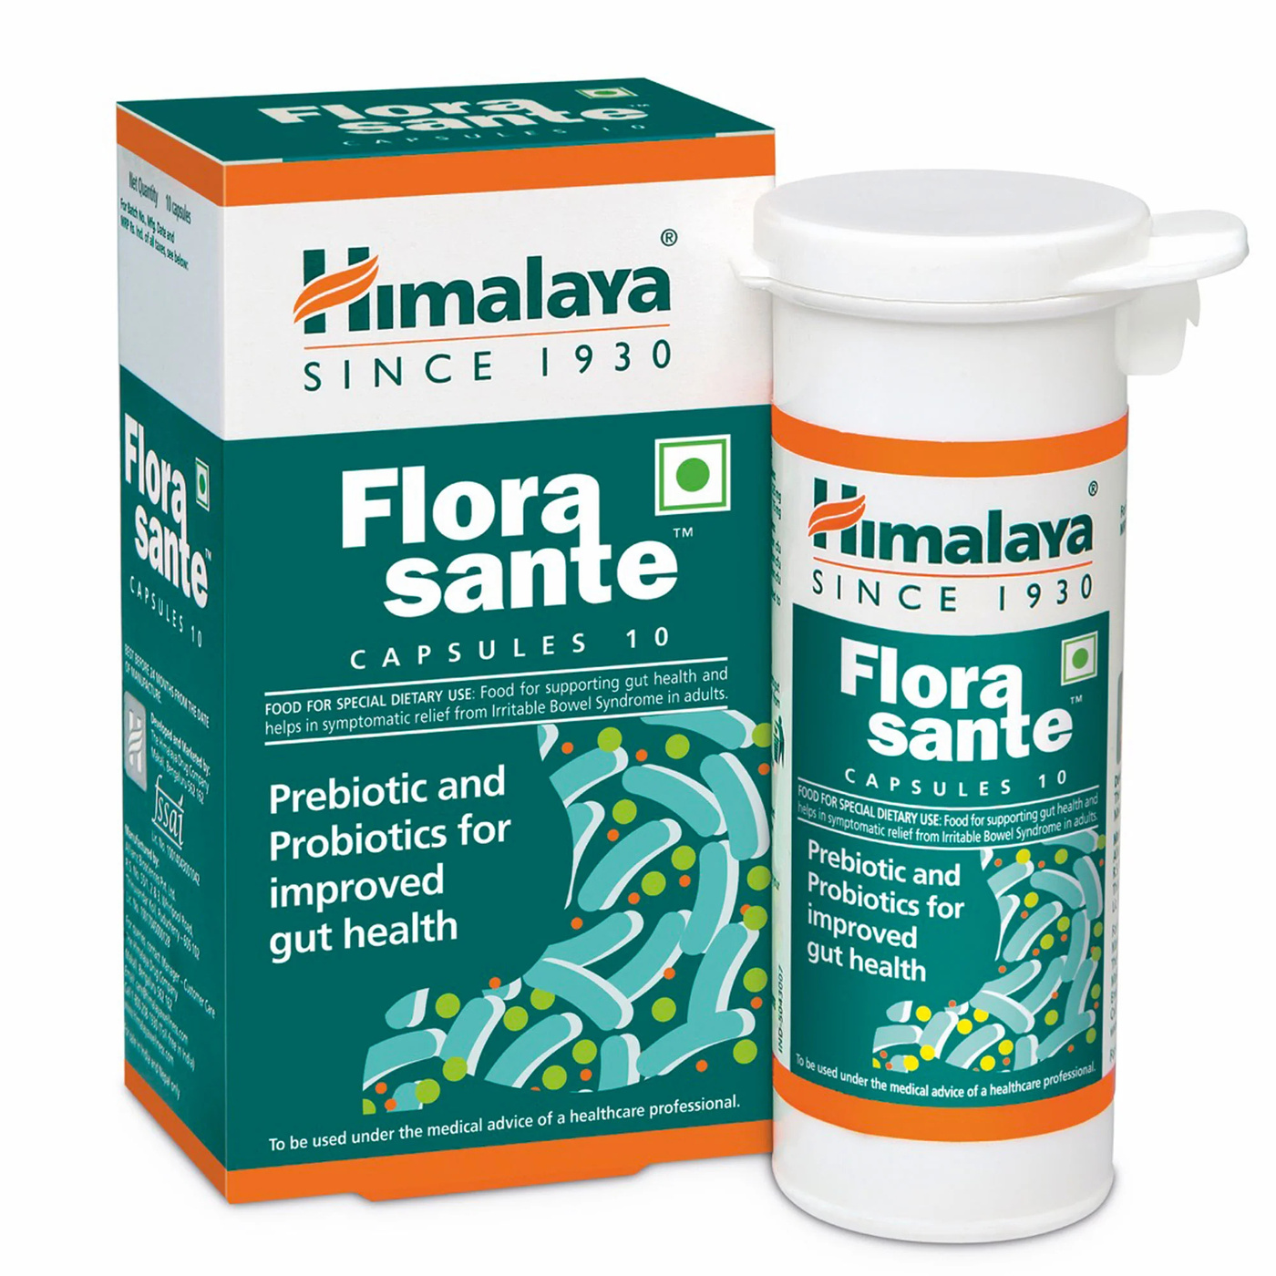

Himalaya.co
Himalaya Probiotic and Prebiotic:
Natural Care for Gut Health
"Healthy Inside, Happy Outside."

Slide 2


Why Gut Health Matters
Gut health is essential for digestion, immunity, and overall well-being.

Slide 3



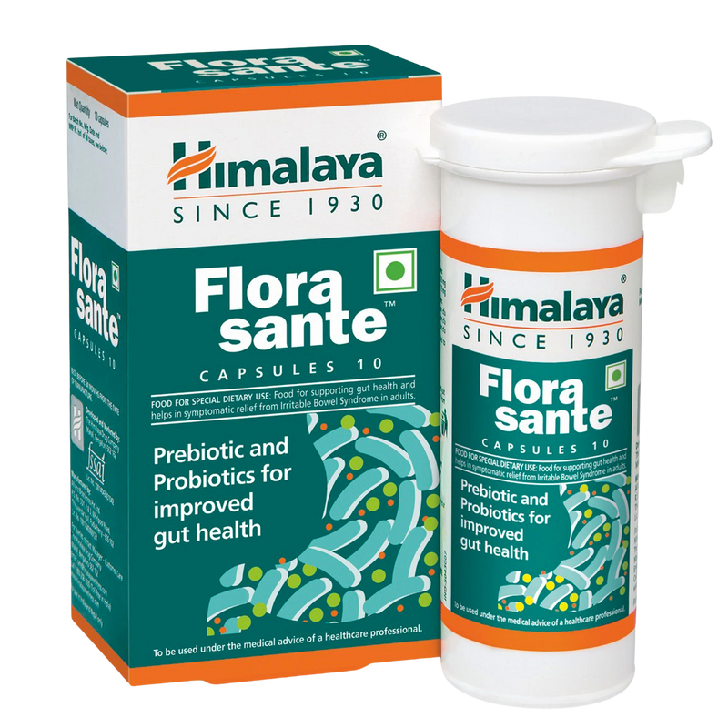



Why Choose Himalaya?
Combines natural prebiotics and probiotics.
Clinically tested and trusted.
Promotes long-term wellness.

Slide 4



Benefits at a Glance
Restores gut flora balance.
Supports digestion and nutrient absorption.
Boosts immunity naturally.
Safe, natural, and easy to use.

Slide 5


Call to Action
Limited-time offer:
"Try now and save 20%!"
Contact Us For More Information
himalayaproducts.com
www.himalaya.com
Follow Us On Social Media
@himalaya.co
Thank You

